Slide 1




Chapter 24
Network Management:
SNMP
Copyright © The McGraw-Hill Companies, Inc. Permission required for reproduction or display.

Slide 2
OBJECTIVES:
To discuss SNMP as a framework for managing devices in an internet using the TCP/IP protocol suite.
To define a manager as a host that runs SNMP client and any agents as a router or host that runs a server program.
Discuss SMI and MIB, which are used by SNMP.
To show how SMI names objects, defines the type of data, and encodes data.
To show how data types are defined using ASN.1.
To show how SMI uses BER to encode data.
To show the functionality of SNMP using three methods.

Slide 3
OBJECTIVES:
To show how SNMP uses two different ports of UDP.

Slide 4
Chapter Outline
24.1 Concept
24.2 Management Components
24.3 SMI
24.4 MIB
24.5 SNMP
24.6 UDP Ports
24.7 Security

Slide 5
24-1 CONCEPT
SNMP uses the concept of manager and agent. That is, a manager, usually a host, controls and monitors a set of agents, usually routers or servers (see Figure 24.1).

Slide 6
Topics Discussed in the Section
Managers and Agents

Slide 7
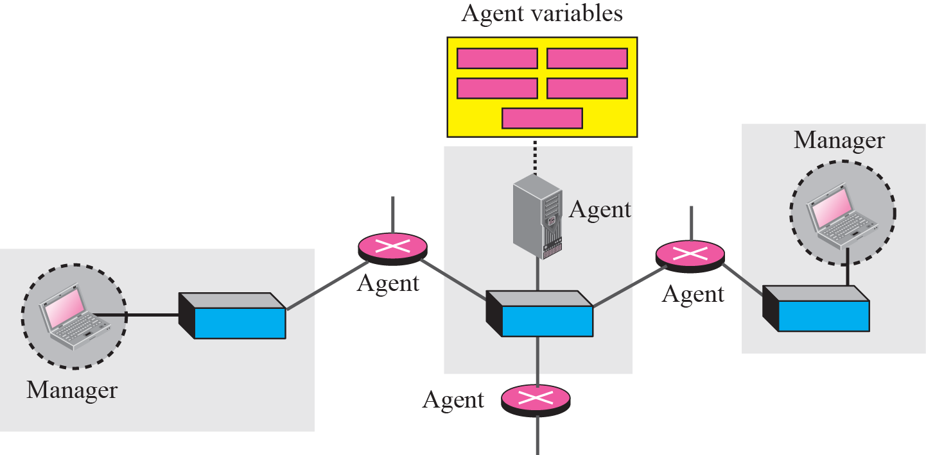
Figure 24.1 SNMP concept

Slide 8
24-2 MANAGEMENT COMPONENTS
To do management tasks, SNMP uses two other protocols: Structure of Management Information (SMI) and Management Information Base (MIB). In other words, management on the Internet is done through the cooperation of three protocols: SNMP, SMI, and MIB, as shown in Figure 24.2.

Slide 9
Topics Discussed in the Section
Role of SNMP
Role of SMI
Role of MIB
An Analogy
An Overview

Slide 10
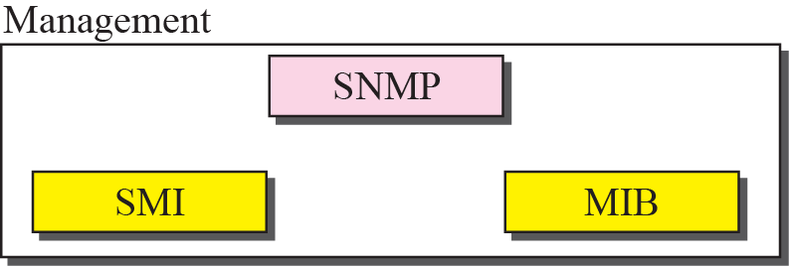
Figure 24.2 Companion of network management on the Internet

Slide 11

Note
SNMP defines the format of packets exchanged between a manager and an agent. It reads and changes the status of objects (values of variables) in SNMP packets.

Slide 12
Note
SMI defines the general rules for naming objects, defining object types (including
range and length), and showing how to encode objects and values.

Slide 13
Note
MIB creates a collection of named objects, their types, and their
relationships to each other in an entity to be managed.

Slide 14
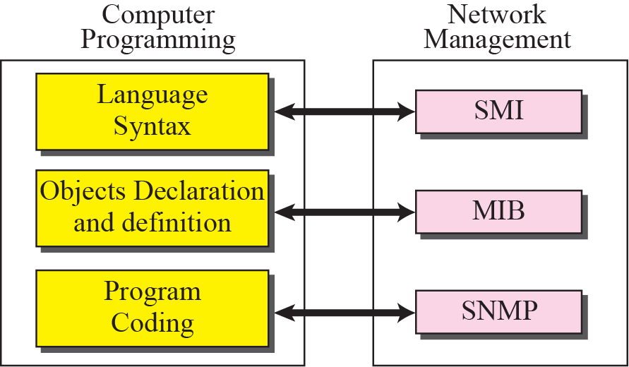
Figure 24.3 Comparing computer programming and network management

